Slide 1
Function point estimation technique
BITS Pilani
Viswanathan Hariharan
2015

Slide 2
Function point (FP) estimation technique
FP technique is used in the early stages of the project to determine the size of the project based on software requirements
The size of software is measured in Function Point units
Once the size is estimated in FPs, we can convert FPs to Effort, based on historical data

Slide 3
Function point (FP) technique
The calculation of size is based on functions supported by the software and the data files used by the software
Functions are of 3 types
External input:
External output
External inquiry
Data files are of 2 types
Internal logical files
External logical files

Slide 4
Types of Functions
External Input (EI): These are functions that modify the data of the system.
Examples: Create Purchase order, Withdraw money from ATM, Update price of a product
External Output (EO): These are functions that send data to external systems or do some processing of data and provide to end users.
Examples: Exporting data to other systems via files or messages, Generating reports involving analysis such as average
External Query (EQ): These are simple inquiry functions that extract data from the system and present to user.
Examples: Show availability of seats in a flight, generating a list of all orders to be shipped tomorrow

Slide 5
Types of Data
Internal Logical Files: These are data files (database tables or flat files) maintained by the system and that reside within the system.
Example: Employee file, Orders file, Payment file, Inventory issue file
External Interface Files: These are data files (database tables or flat files) maintained outside the system but needed by our system.
Example: Schedule of flights of other airlines, Interest rate offered by different banks

Slide 6
Functions Points
Steps to calculate Function points
Assign FPs to each Function & each File based on its complexity
Total the FPs. This is called Unadjusted FP or Raw FPs
Multiply the Unadjusted FPs by an adjustment factor. The adjustment factor is determined / based on 14 characteristics of the system

Slide 7
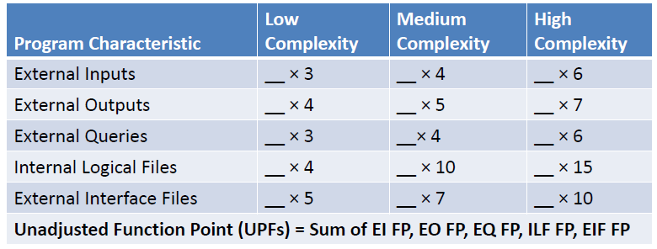
FPs for Functions & Files
Here are the FPs for different types of functions and files, based on their complexity

Slide 8
Determining complexity of EI, EO & EQ
Complexity of functions is determined based on number of Data Element Types referenced and File Types referenced, by the function
Example #1: The function “Create purchase order” (EI), updates the fields – PO#, Date, Description, PO amount, Customer ID, Customer name, etc. These are the DETs maintained by the function
Example #2: The report “Generate Sales analysis report” (EO) displays the following fields on the report – Product ID, Product name, City, Month, Total quantity sold, Total Sales revenue, Name of Salesman. These fields are the DETs of this function. In order to perform this function, it uses 3 files namely – Sales file, Product file and Salesman file. These are the File Types referenced

Slide 9
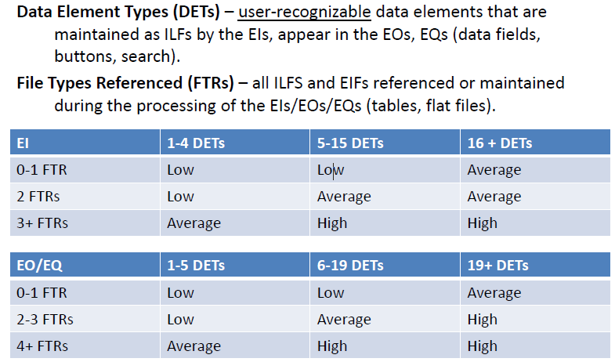
Determining complexity of EI, EO & EQ
Here is the matrix to determine the complexity

Slide 10
Determining complexity of files
Complexity of files is determined based on 2 characteristics of the file namely - Data Element Types (DET) and Record Element Types (RET)
The meaning of DET & RET is explained below:
Example:
Employee file can have the following logical groupings
Basic data of employee such as Name, Data of birth, Address, etc.
Past employment info such as Name of company, Start date, end date, Last designation, etc.
Past project info such as Name of project, From date, To date, Role in project, etc.
In the above example,
the DETs are Name, date of birth, Address, Name of company, From date, etc.
We have 3 types of logical grouping of data namely - Basic data group, Past employment info group, Past project info group. Hence we have 3 RETs

Slide 11
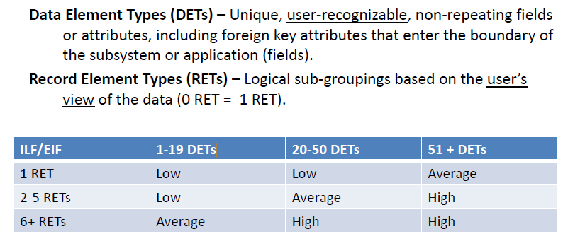
Determining complexity of LIF & EIF
Here is the matrix to determine the complexity

Slide 12
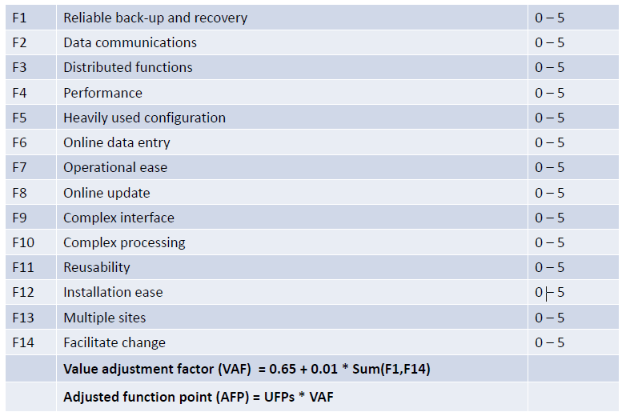
Adjustment factor
Adjustment factor depends on the rating of 14 system characteristics
We need to rate each characteristic on a scale of 0-5
The adjustment factor is calculated using a formula shown below

Slide 13
Example of FP calculation
Functions | Name of Function | Type | Complexity | FP
 | Inquire balance | EQ | Low | 3
 | Withdraw money | EI | Medium | 4
 | Generate statement | EO | High | 7
 | ...
 | ...
Files | Name of File | Type | Complexity | FP
 | Account file | ILF | Medium | 10
 | Transaction file | ILF | Low | 4
 | TDS rates | EIF | Medium | 7
Total FPs (unadjusted) |  |  |  | 35
Adjustment factor |  |  |  | 1.1
Adjusted FP |  |  |  | 38.5

